Slide 1

Testing Overview of Amazon Drone Delivery Vehicle Simulator
Presented by Project Team 3
Anuj Rakheja
Arjun Vekaria
Neeraj Mishra
Purn Prem Kumar
Sneha Chitre

Slide 2

Contents
Project Demo
Bugs found and fixes in project part 3
Bugs found and fixes in project part 4 with JaCoCo
Bugs found and fixes in project part 5 with JaCoCo

Slide 3
DEMO

Slide 4
Project Part 3 (Bugs found)
PWR60 was enabled as GREEN. Should be RED since its an alarm.
ESR was enabled as BLUE. Should be YELLOW since it’s a warning.
ESR was disabled as RED. Should be WHITE as specified.
ISRZ was enabled as RED. Should be GREEN as it’s an indicator.
DC was enabled as YELLOW. Should be RED as it’s an alarm.
Code does not allow pilot to set shield position while ESR is ON.
POS was enabled as YELLOW which should be RED as it’s an alarm.
Method for setIsrz_persistence_count not declared.
Method for getIsrz_persistence_count not declared.
Variable ISRZ not initialized.

Slide 5
Project Part 3 (Bugs found) (Cont.)
Semantic Error: Oof instead of Off in CompluteSimulation.java
PWR60 Alarm mentioned on wrong condition (160 instead of 180).
ISRZ Indicator mentioned on wrong condition (should be on SHDPOS='R' &Vf<25 & alt<50).
ISRZ Persistence count was not set to 7.
MP1 displayed should be on Altitude >=50 instead on 40.
Array values for Altitude array were wrong. (should be 0.0, -3.2, - 1.4, 0.0)
Array values for Power Watts per second were wrong.(should be 0.0, 2.0, 1.0, 0.0)

Slide 6
Project Part 3 (Bugs found) (Cont.)
ESR Persistence count was set to 3 instead of correct value 5.
Time was wrongly set to 95 instead of 90.
Shield position set wrongly to Deployed D instead of Retracted for ESR to be true.
Persistence count not set for ESR to be true.
Shield command not set to R for ESR to be true.
Motor Program MP3 does not exist yet mentioned instead of MP2.

Slide 7
Project Part 3 (Bugs found) (Cont.)
Additions made to code:
Additional condition added so that ISRZ can be set to true.
Additional block of code added to keep ISRZ Indicator to last for 7 seconds only.
Added missing code for (40%-60%) pkg damage concept.
Added code for missing scenarios –
Package not delivered
Drone crash scenarios
For situation when shield position is Deployed ‘D’.

Slide 8
Project Part 4 (Bugs found)
Following two new bugs were found in project part 4.
Shield command (SHDCMD) button was getting updated based on Shield position SHDPOS value instead of SHDCMD value.
ESR Latch check has been added as ESR latch value was not taken into consideration while updating GUI.

Slide 9
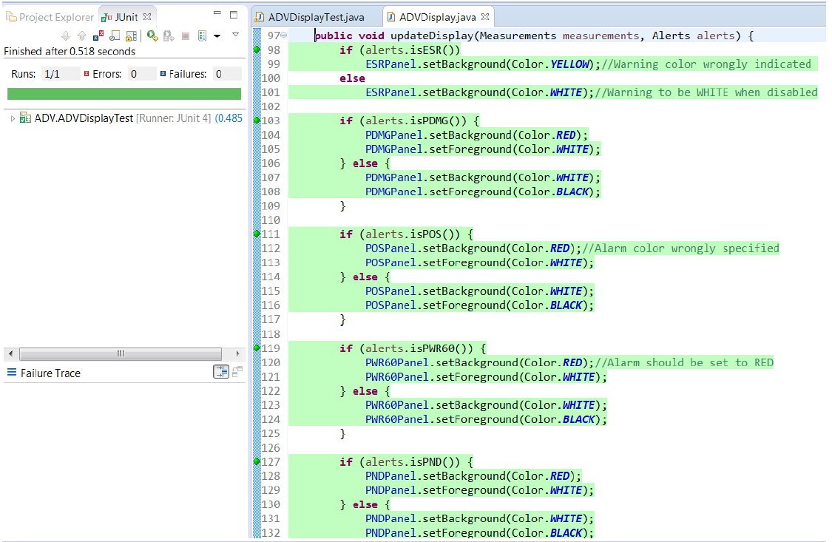
Project Part 4 (JACOCO & JUnit)

Slide 10
Project Part 4 (JACOCO & JUnit)(Cont.)

Slide 11
Project Part 4 (JACOCO & JUnit)(Cont.)

Slide 12
Project Part 5 (Bugs found)
Following new bugs were found in project part 5.
Modified condition which sets ESR warning to update ESR value correctly.
Added one more missing condition measurements.getshield_position().equals("D") to set ISRZ alert as per ADV domain rule.

Slide 13
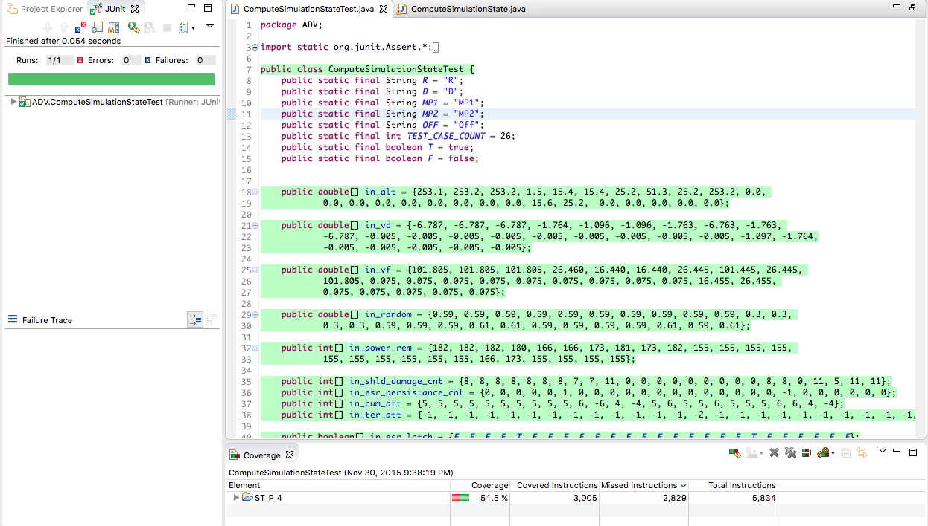
Project Part 5 (JACOCO & JUnit)

Slide 14
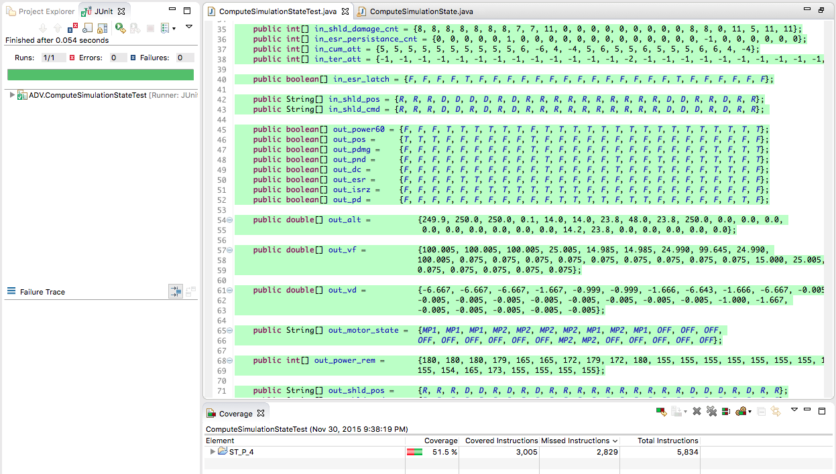
Project Part 5 (JACOCO & JUnit)(Cont.)

Slide 15
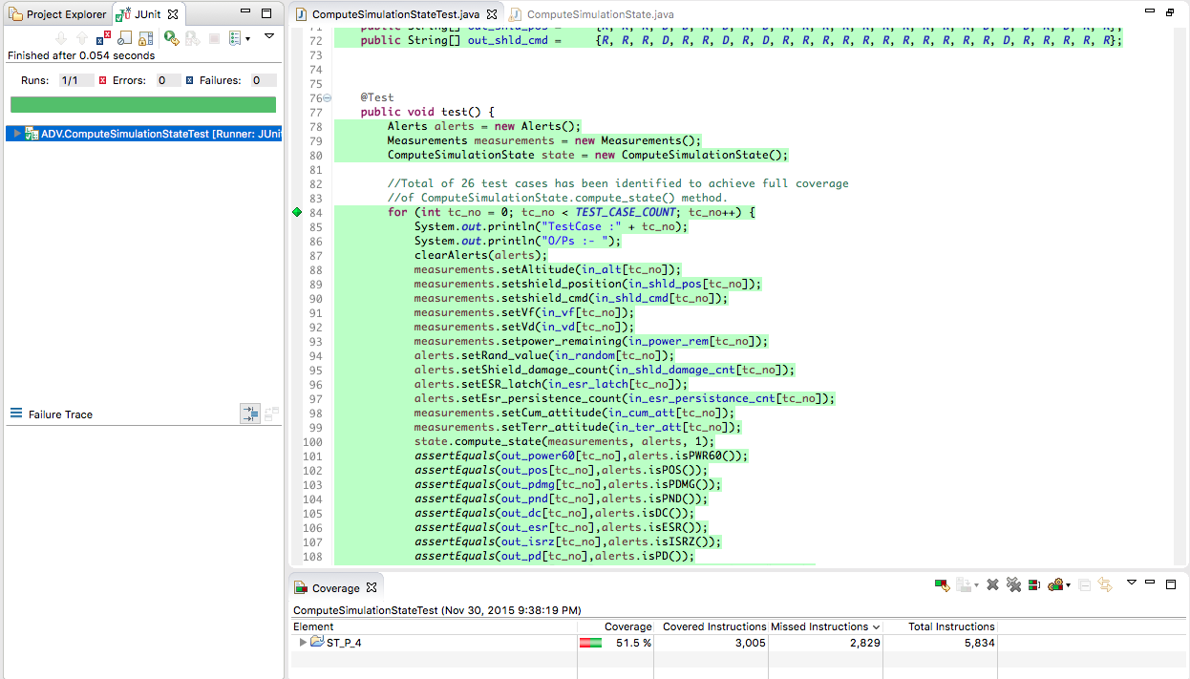
Project Part 5 (JACOCO & JUnit)(Cont.)

Slide 16
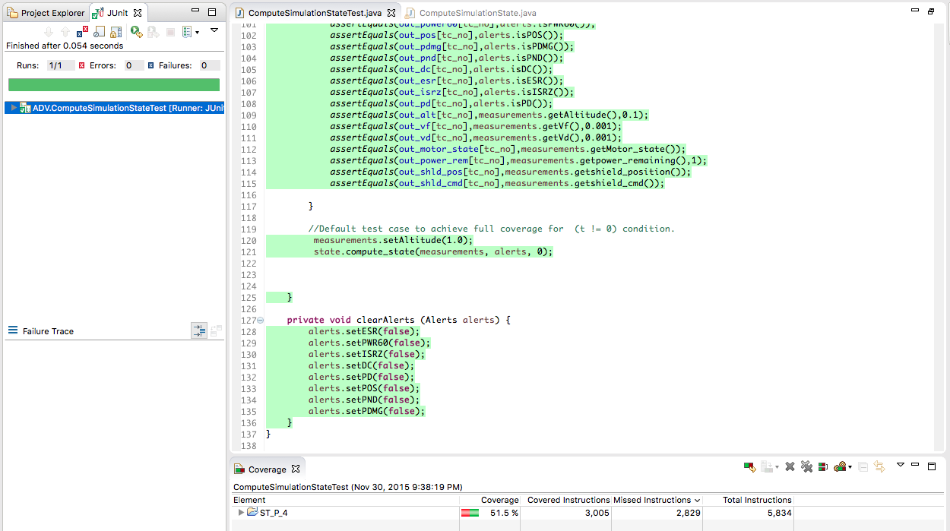
Project Part 5 (JACOCO & JUnit)(Cont.)

Slide 17
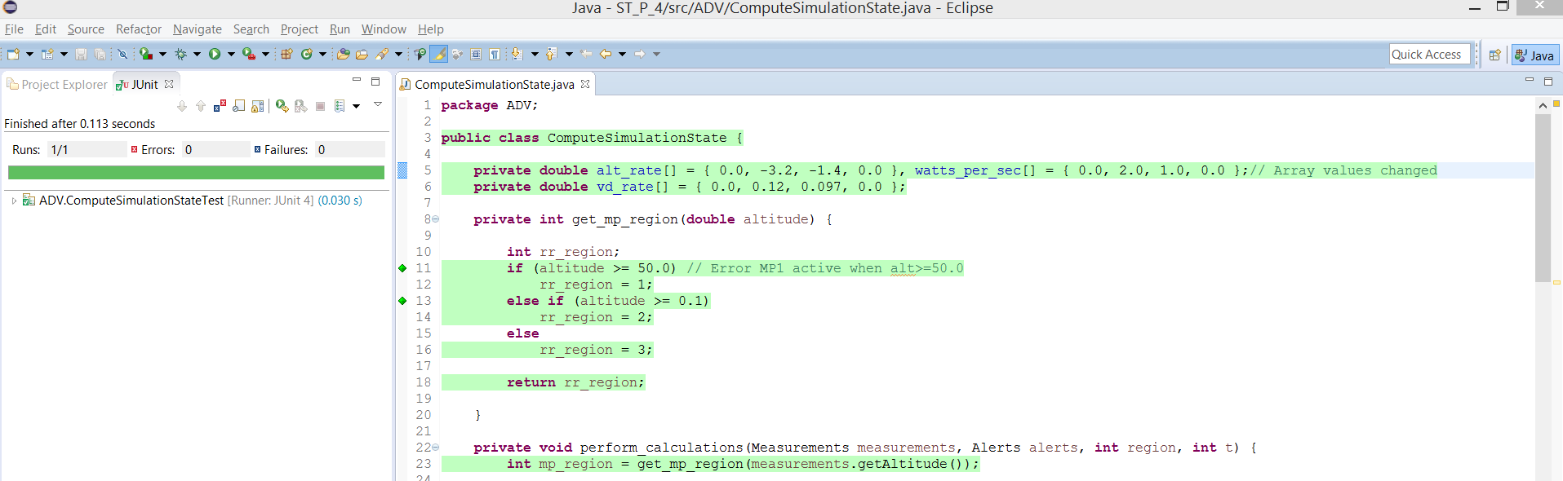
Project Part 5 (JACOCO & JUnit)(Cont.)

Slide 18
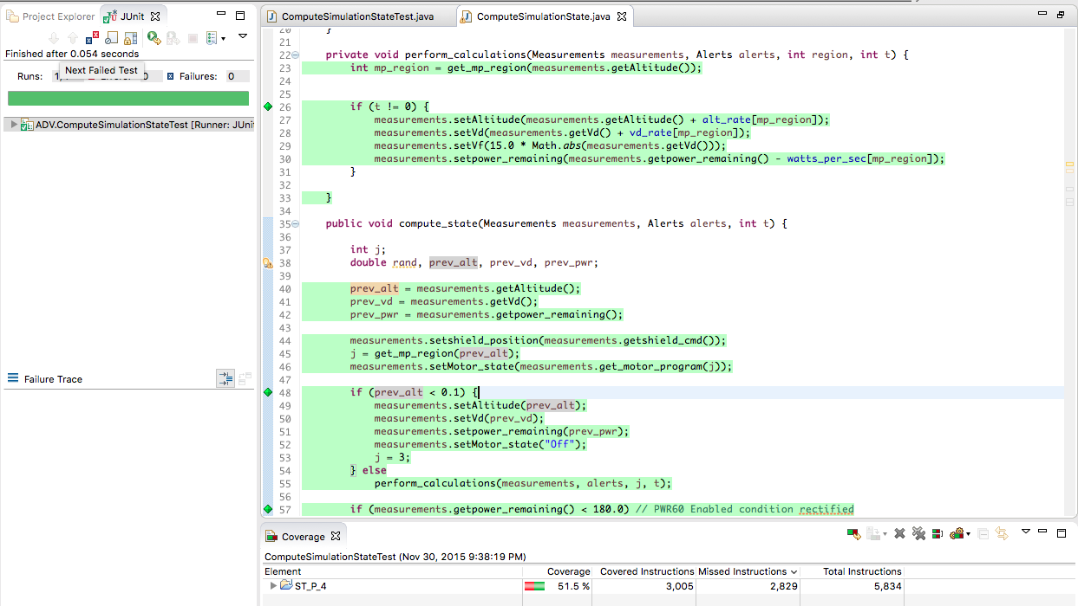
Project Part 5 (JACOCO & JUnit)(Cont.)

Slide 19
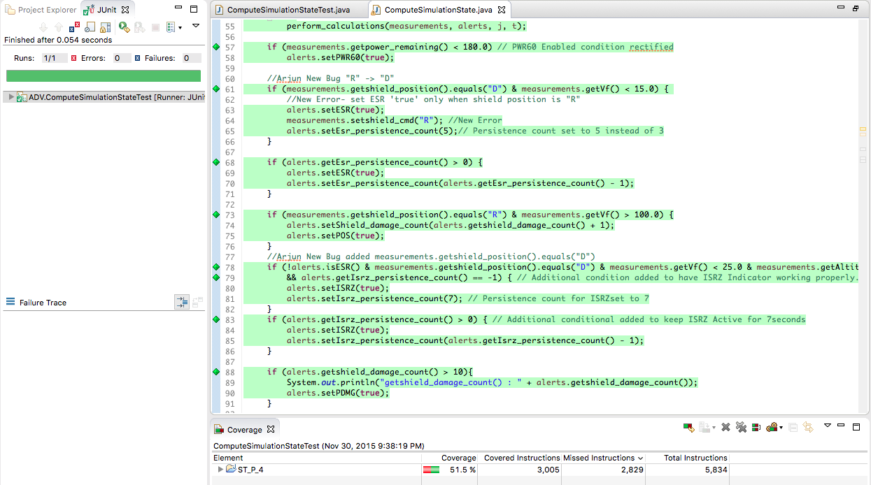
Project Part 5 (JACOCO & JUnit)(Cont.)

Slide 20
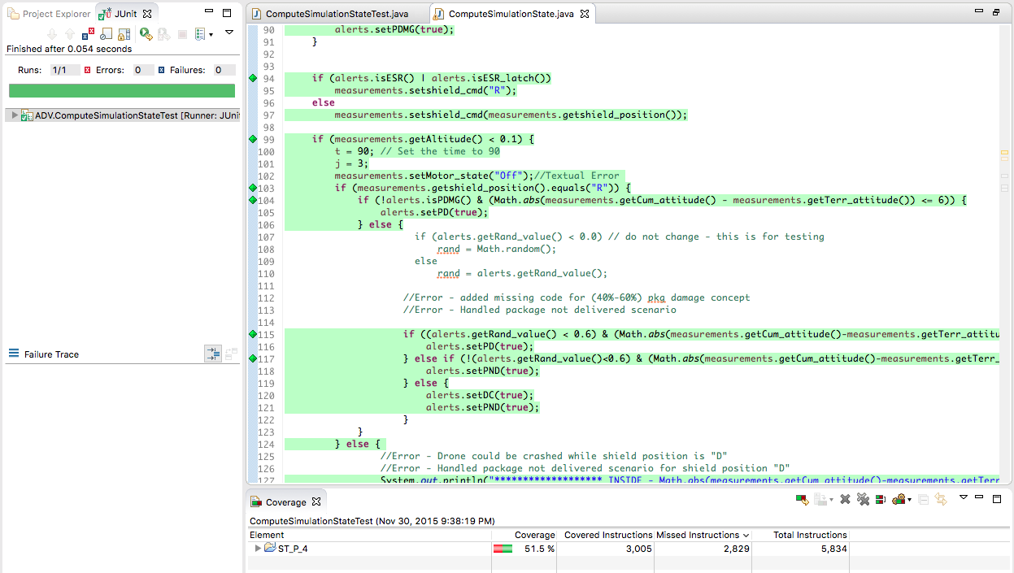
Project Part 5 (JACOCO & JUnit)(Cont.)

Slide 21
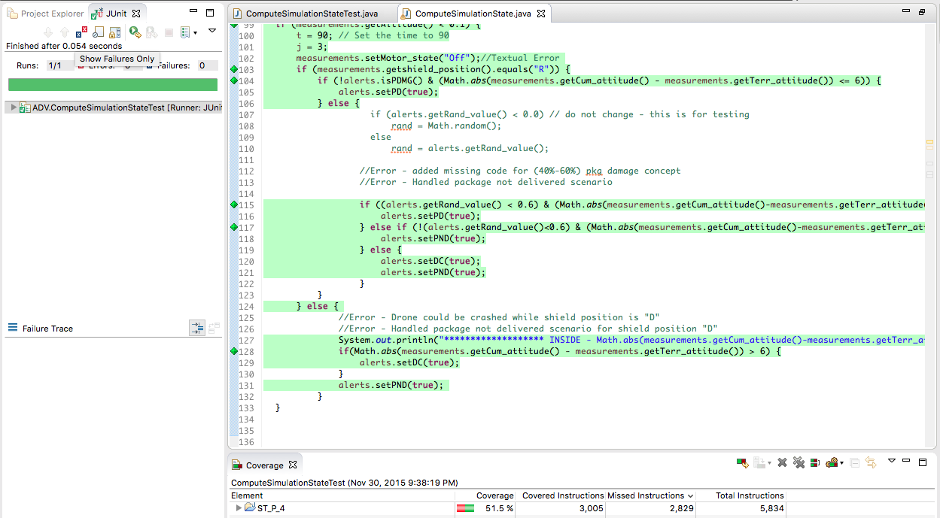
Project Part 5 (JACOCO & JUnit)(Cont.)

Slide 22


